Slide 1
Python Module 2
Basic Operators
Data Analytics

Slide 2


























Anaconda
Jupyter
Data Types
Flow control
Classes
Containers
Machine Learning
Data Science

Slide 3
Text type:
Strings (str) are a sequence of characters. There are two ways you can assign a str variable in Python
x = “Good morning” - specifies data type by assigning a value.
x = str(“Good morning”) - specifies the data type using a constructor function (the first method that is called on object creation).
Numeric:
Numeric data types represent the data which has numeric value and can be written differently, depending on the value type.
Float - An example of a numeric float is 3.6 and it can have a decimal place up to 15.
Integer - An example of a numeric integer is 3 and is only limited by the memory space available in Python.
Complex - An example of a complex number is 5j. Complex numbers in Python are made up of real numbers and imaginary parts. For instance, 5 (real number) j (imaginary part).

Slide 4
Sequence:
Lists are used to store multiple items in a single variable.
x = [“blue”, “purple”, “red”]
x = list ((“blue”, “purple”, “red”))
Tuples are used to store multiple items in a single variable.
x = [“dog”, “cat”, bird”]
x = ((“dog”, “cat”, bird”))
Range returns a sequence of numbers, starting from 0. Starting at 1 from default and stops before a specified number.
x = range (10) - Specifying a range is written the same in python, with a constructor.
Mapping:
Dictionaries (dict) store data values in value pairs.
x = {“name” : “Sam”, “age” : 40}
x = dict (“name” : “Sam”, “age” : 40)
Set:
Sets (set) are used to store more than one item within a single variable.
x = {“dog”, “bird”, “cat”}
x = set(("dog", "bird", "cat"))
Boolean:
Bool (bool) is a method used to turn a value into a boolean value , i.e. True or False.
x = True
x = bool(5)

Slide 5
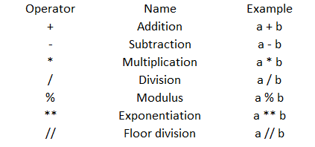
Python Operators

Slide 6
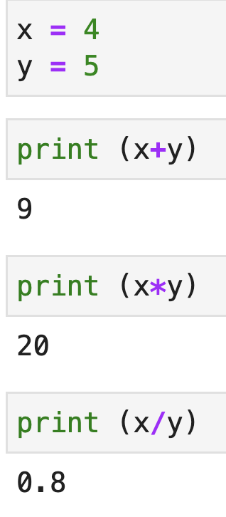
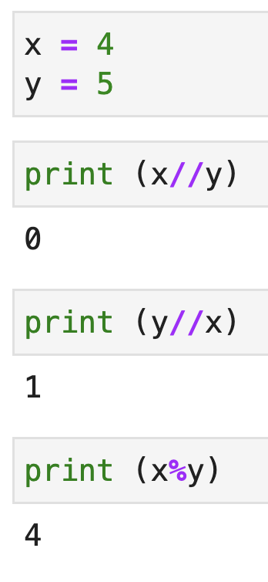

Slide 7
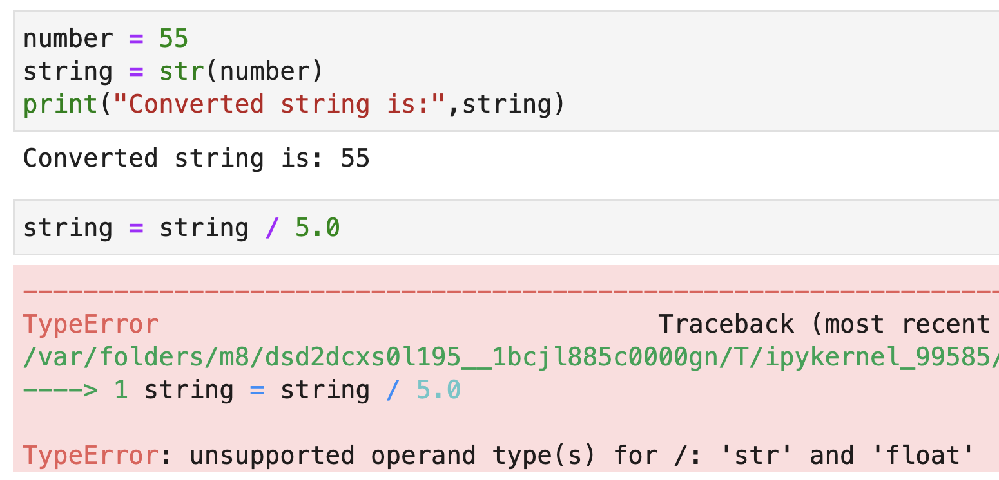

Slide 8
Importing Modules
The math module can be imported with the statement:
import math
documentation: https://docs.python.org/3/library/math.html
t=5
y=math.sin(t)
Module
Function
Argument

Slide 9
math constants
x = math.pi
y = math.degrees(x)
print (x, y)
3.141592653589793 180.0
r = 3
circle_area = (math.pi) * (r**2)
print ("area of circle with radius ", r, " = ", circle_area)
area of circle with radius 3 = 28.274333882308138

